Slide 1

Substation and Distribution Automation
Module 10: Introduction to Microgrids

Slide 2
Module 10 Overview
Part 1: Microgrid Overview
Part 2: Microgrid Configurations
Part 3: Existing Microgrids
Part 4: Microgrid Control

Slide 3
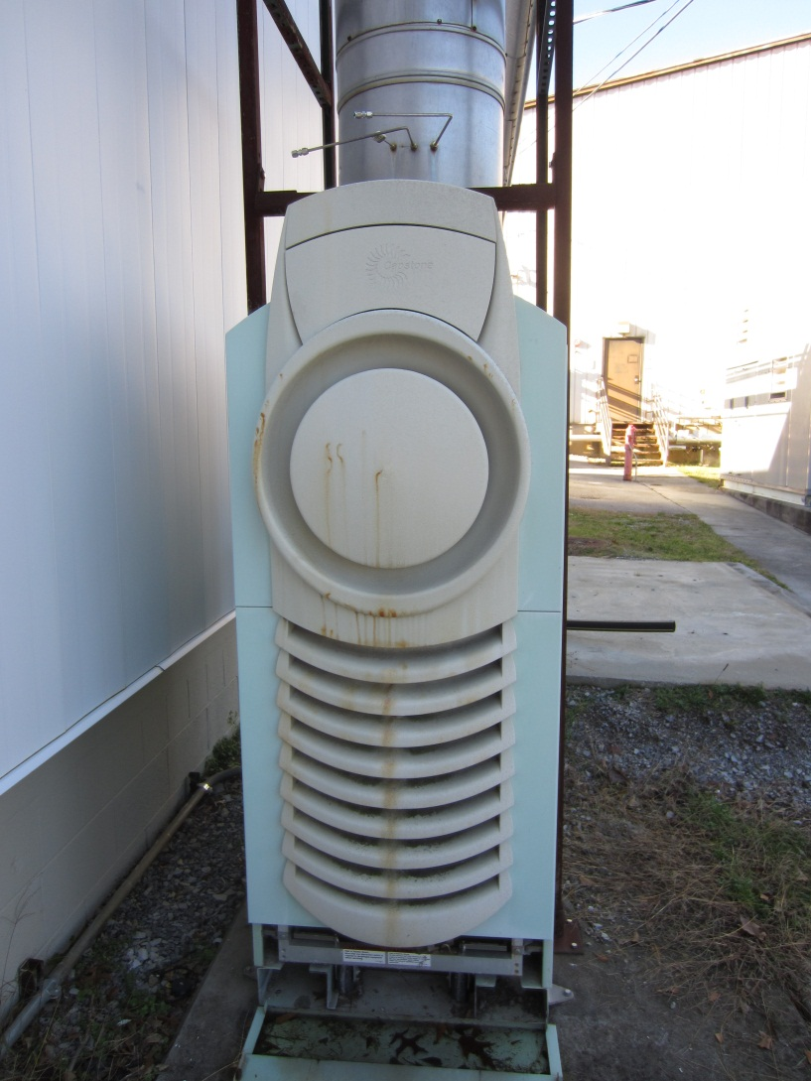
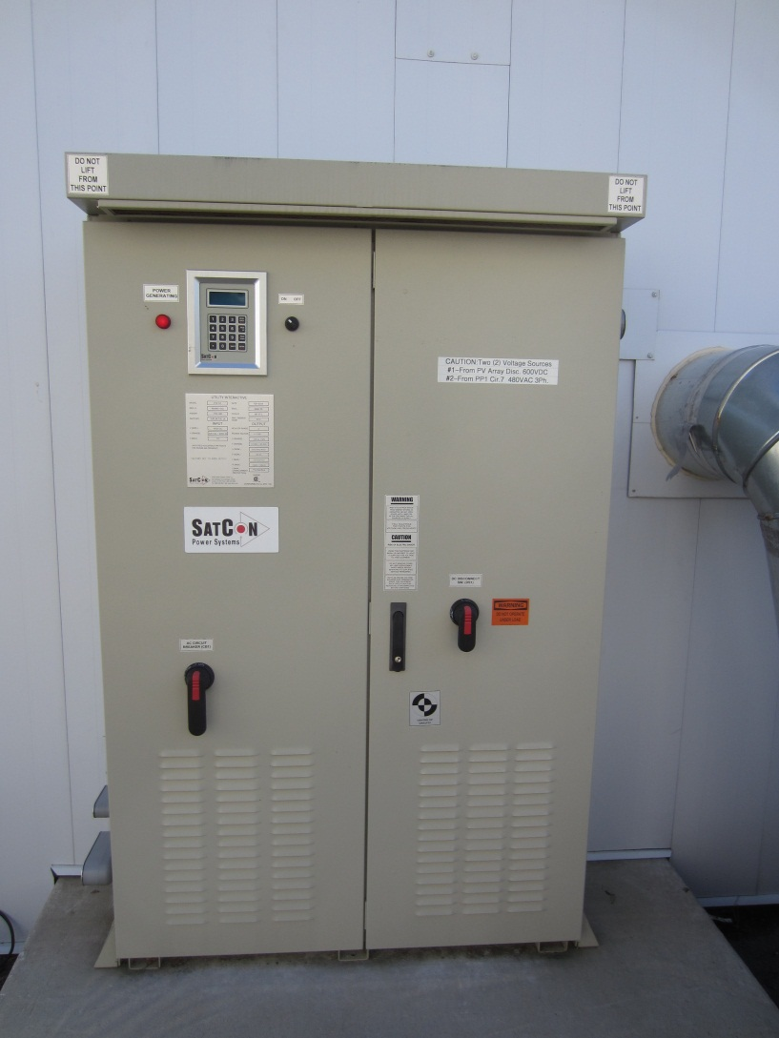
Part 1: Microgrid Overview

Slide 4
What are Microgrids?
Definition of microgrid¹: Group of locally-controlled Distributed Energy Resources (DERs) connected to a low voltage (≈≤ 1 kV) or medium voltage (≈ 1 to 69 kV) distribution network.
Behaves as a single producer or load
Can operate in islanded mode
Small isolated power systems can also be seen as microgrids
Microgrids are essentially the small local paradigm that power systems started with, except that they have the ability to interconnect into the existing bulk power system in some situations.
Additionally, because of the advances in technology, modern microgrids are significantly more efficient and capable.
The ability to generate electricity locally means that distance events will not impact local demand.
¹: N. Hatziargyriou et. al, “Microgrids” IEEE Power & Energy Magazine, July/August 2007

Slide 5
Why Microgrids?
Microgrids represent a possible method to better engage a way to enable DERSs:
Increase energy efficiency through combined heat and power (CHP)
Reduce carbon emissions through the use of local renewables
Increase local power quality and reliability
Reduced line losses
Transmission investment deferral
Reduce expensive fuel consumption in remote isolated microgrids
Challenge of controlling large number of DER can be addressed by microgrids. Microgrids coordinate DERs in a decentralized way reducing the control burden on the grid.
Enable provision of heterogeneous levels of power quality and reliability (PQR). For example, very high PQR provided to essential services like hospitals and communication equipment, while lower PQR provided to non essential loads like water pumps.
All of these benefits come at the cost of significantly more equipment and the need to develop new control strategies.
The regulatory impacts of this technology must also be examined. Specifically, if the utilities are required to provide service to a customer who only requires power a few times of year because of their normal operation on a microgrid, how is the utility to recover their investment? This is an issue of policy, regulation, and social equity.

Slide 6
Classification of Microgrids
Utility Microgrids: Urban and rural
Objectives: Outage management and renewable integration
Transition to grid independent or isolated operation: faults, maintenance
Industrial/commercial microgrids: multi- and single-facility
Objectives: Power quality, reliability and efficiency
Transition to grid independent or isolated operation: faults, power quality, energy price, maintenance
Remote microgrids
Objectives: Electrification of remote areas, reduce fuel consumption through renewable integration

Slide 7
Microgrid Components
Elements of a microgrid:
Generation: local generation that produces electric.
Energy storage: local storage that is controllable.
Lines: overhead and underground to interconnect the system.
Switches: devises are needed to reconfigure and to connect with the distribution level.
Loads: the end-use customers.
Control systems: some form of control must exist to ensure that frequency and voltage are maintained within the required range.
These are exactly the same elements of an interconnected power system, but on a local scale.
As a result, microgrids require all the controls and equipment necessary to operate a power system but without the benefit of large central generation.

Slide 8
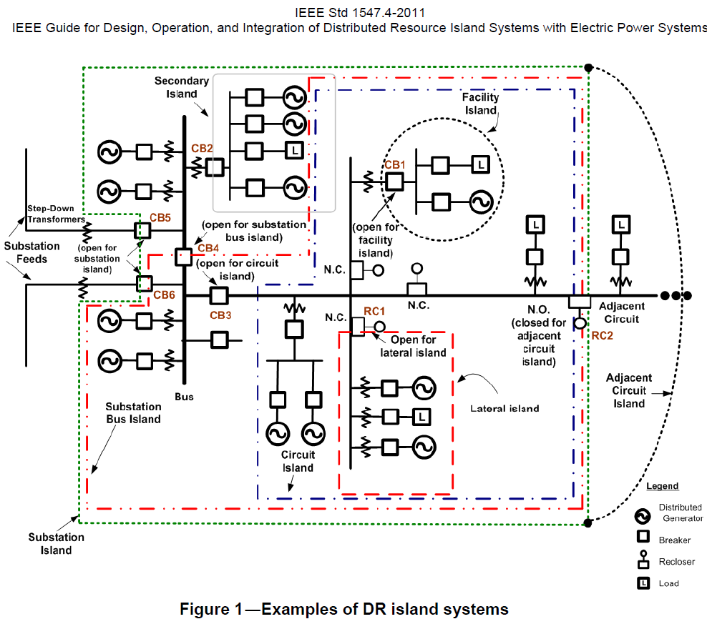
Part 2: Microgrid Configurations
The formation of a microgrid can be achieved through a number of different topological structures.
This section will examine 7 specific configurations as outlines in IEEE std. 1547.4.
Because of the complexity of microgrids there are numerous configurations that are not specifically addressed in this presentation.
Regardless of the configuration, the formation and reconnection of a microgrid must be carefully coordinated with the local distribution system operator.

Slide 9
Local Electric Power System Island Configurations
IEEE std. 1547.4 specifically calls out 7 microgrid configurations:
Facility island
Secondary island
Lateral island
Circuit island
Substation bus island
Substation island
Adjacent circuit island
These 7 configurations are based on the structure of the microgrid with respect to the portion of the distribution system that it engages.

Slide 10
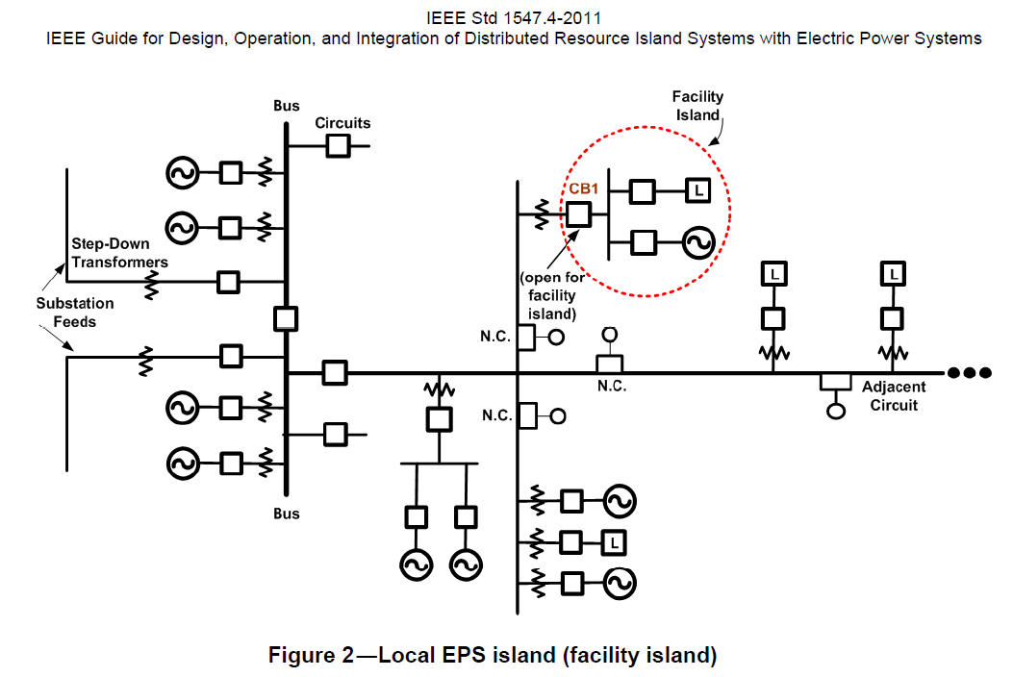
Facility Island
A facility island involves the islanding of a single customer.
This can generally be defined as a single metered customer.
This is similar to how a hospital or other critical load would operate during a blackout when they are supplied by local emergency generators.
Facilities that have this emergency capability rarely operated islanded for other reasons because of emission limitations on emergency diesel generators.
This is these simplest configuration from the perspective of interacting with the power system operator.

Slide 11
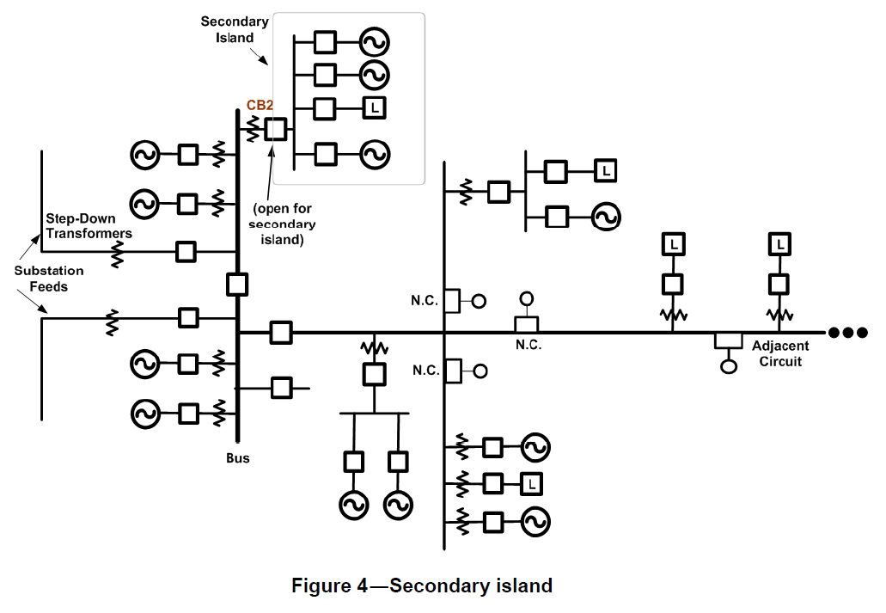
Secondary Island
A secondary island can involve one or more customers who interconnect via the secondary distribution system.
For residential customers this would occur down stream of the single phase center-tapped transformer.
For larger commercial and industrial customers this could occur at the quadraplex connection.
In North America secondary systems are generally only used for short connections, <150 ft.
As a result of small secondaries in North America this is not a common configuration.

Slide 12
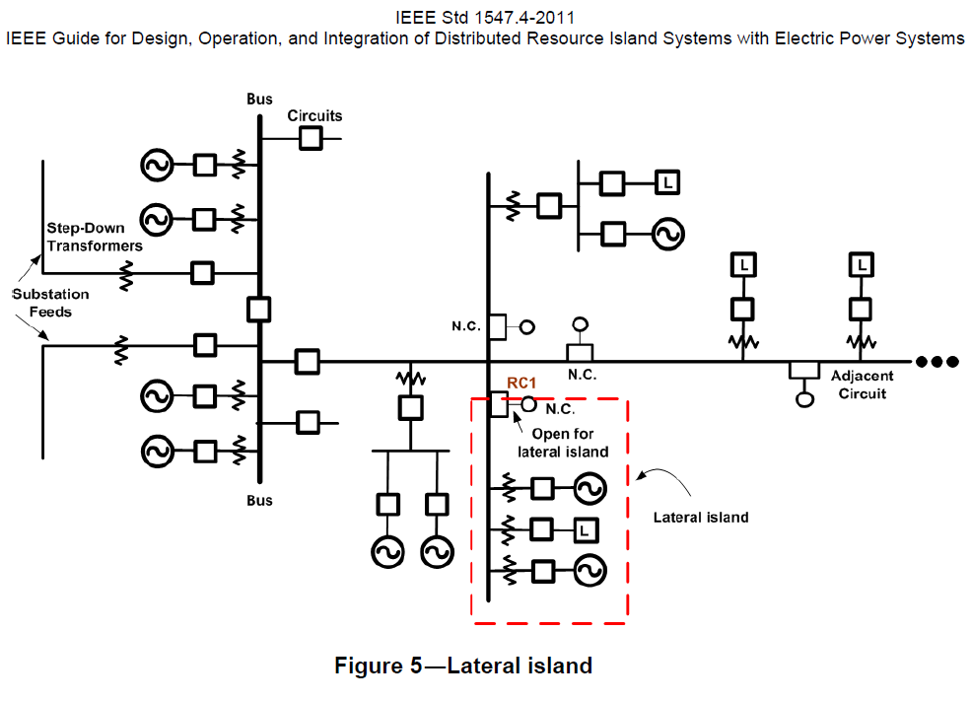
Lateral Island
A lateral island can involve the islanding of an entire single phase or multiple phase lateral.
Depending on the number of customers supplied by the lateral the size of the island can vary.
This type of configuration could be used when an office or research park has the capacity to operate in an islanded manner.
With a lateral island the local utility will have to be more involved since it now contains elements of their distribution feeder.

Slide 13
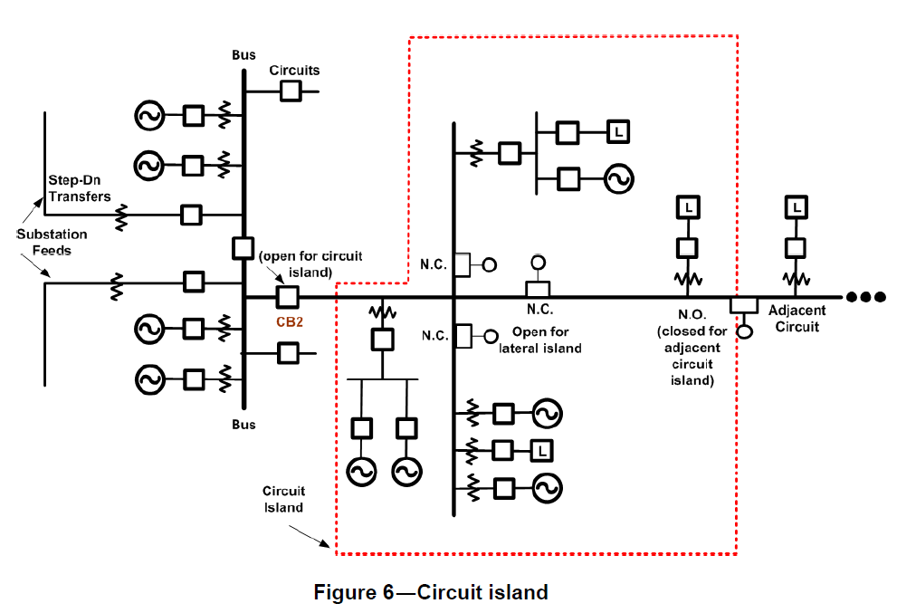
Circuit Island
In a circuit island an entire distribution feeder has the ability to operate islanded.
It would be expected that a circuit island would be operated by the local utility or in close cooperation.
An island of this size will potentially have numerous generation and load balancing resources and as such poses a significantly more complicated control problem.
A circuit island can have mixed end uses such as residential, commercial, and/or industrial, further complicating the control issues.
Protection on this system will also be complicated by the potential for bi-directional power flows.

Slide 14
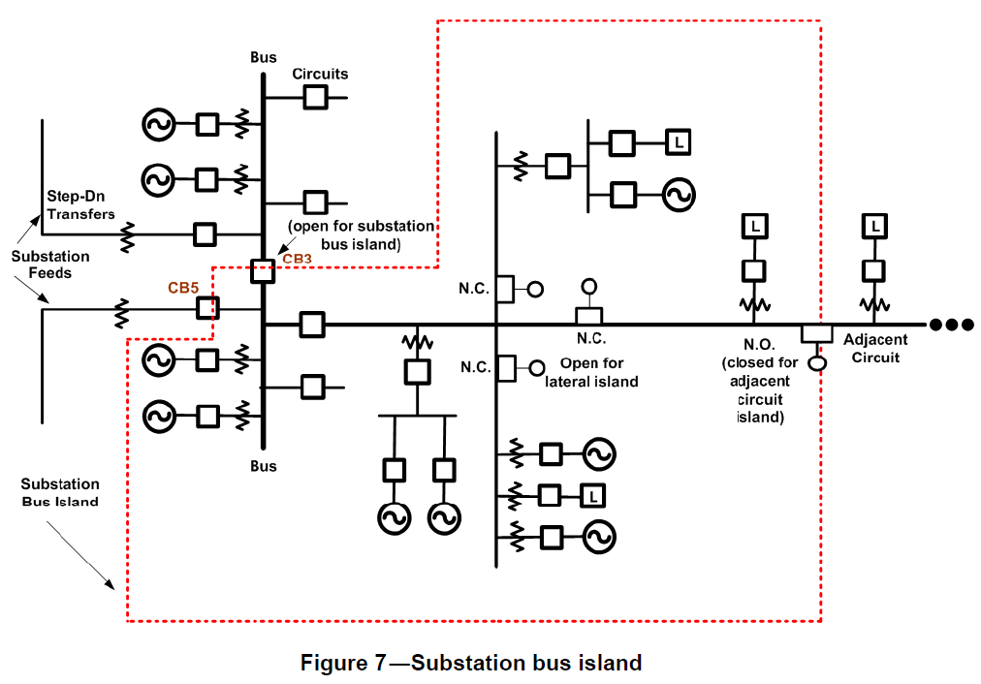
Substation Bus Island
A substation bus island contains an entire bus at the substation.
This can include one or more distribution feeders as well as equipment, and potentially generation, located at the substation.
This configuration can require a complicated protection scheme because of the need to protect the substation bus and feeder under normal and islanded conditions.
Coordination of generation at the substation and on the feeder must be coordinated to achieve frequency and voltage control.

Slide 15
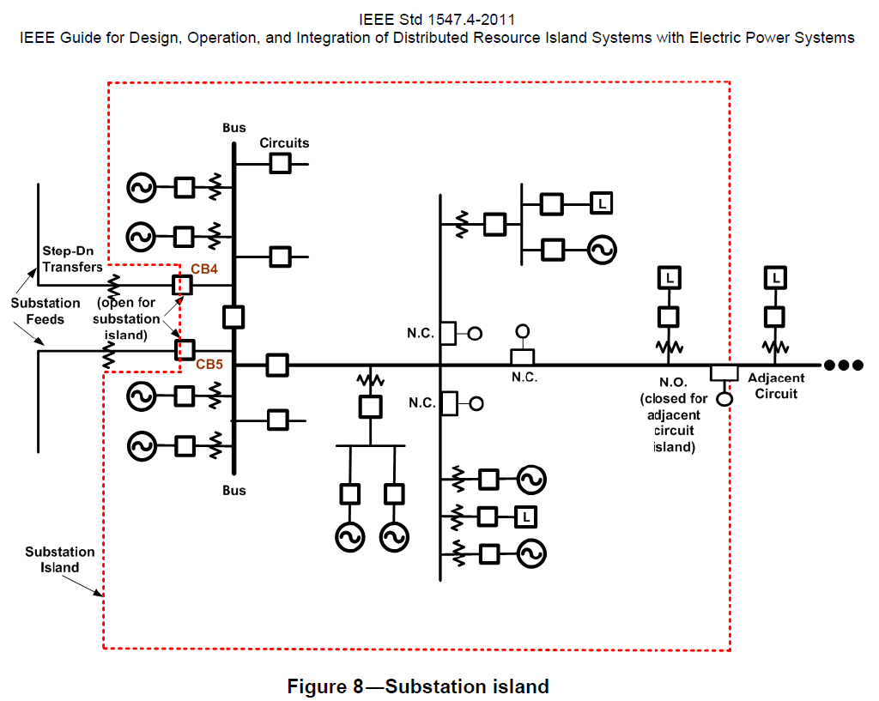
Substation Island
In this configuration then entire substation acts as an island.
This can form a very complicated system with multiple switching configurations at the substation.
Multiple distribution feeders supplied from different buses will provide a complicated protection scheme.
This is the most compressive microgrid and would require significant local generation resources to supply all of the load.

Slide 16
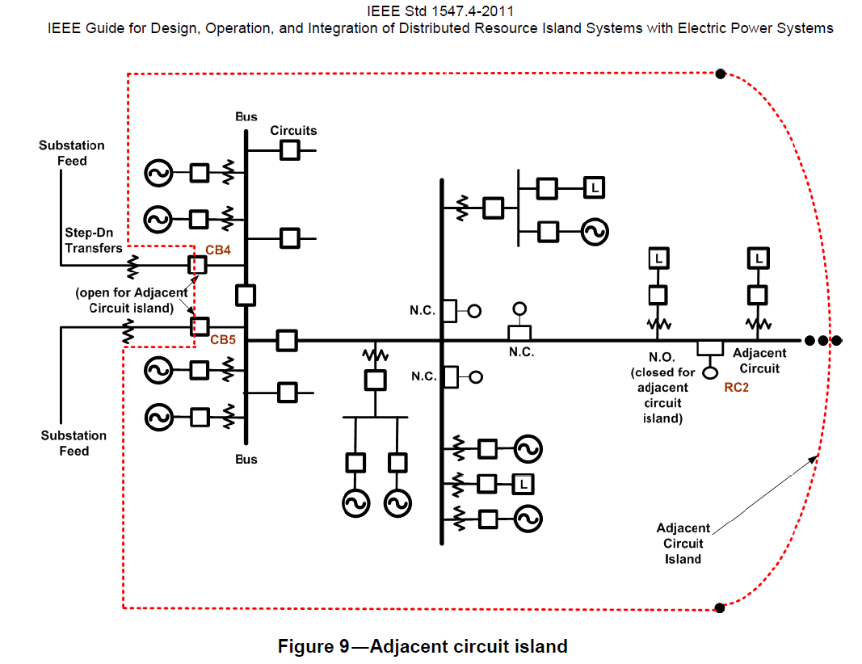
Adjacent Circuit Island
An adjacent circuit island involves supplying a portion of the adjacent circuit from the existing island.
The existing island can be operating in many of the previously mentioned configurations.
Lateral island
Circuit island
Substation bus island
Substation island
The protection scheme for this will be complicated since the power is supplies to the adjacent feeder from the opposite direction of the normal power flow.

Slide 17




Part 3: Existing Microgrids
Microgrids have been deployed all around the world in various forms.
Microgrids were one of the early earliest forms of power system but evolved into interconnected systems.
In this section we will look at modern example systems from the United States, countries of the European Union, Japan, and Canada.
While we have selected these 4, other regions of the world have also deployed microgrids in various forms.

Slide 18

Existing U.S. Microgrid Implementations
AEP / CERTS microgrid test bed, Ohio
Perfect Power, Illinois Institute of Technology
Santa Rita Jail, California
Smart Power Infrastructure Demonstration for Energy Reliability and Security (SPIDERS), Hawaii and Colorado

Slide 19
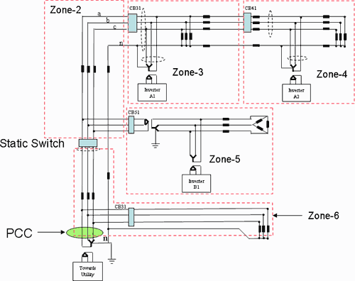
AEP / CERTS Microgrid Test Bed
The microgrid was operated in the Columbus Ohio area for American Electric Power (AEP).
This microgrid was developed to test three key concepts:
The ability to seamlessly separate and reconnect to the electrical power system.
Develop protection methodologies that do not require the presence of high fault currents.
Voltage and frequency control without the need for high speed communications systems.
The test bed included three feeders, load banks, a induction motor, and three micro sources with heat recovery systems.
Voltage and frequency control systems were operated as well as protective relays.
R. H. Lasseter et. al, “CERTS Microgrid Laboratory Test Bed,” Submitted to IEEE Transactions on Power Delivery, 2010

Slide 20
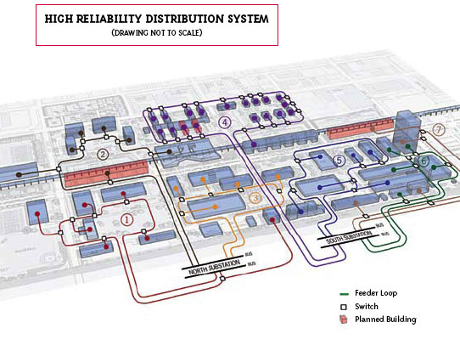
Perfect Power at the Illinois Institute of Technology
This system was deployed to address the fact that IIT has an average of 3 outages a year with their current infrastructure.
This is an example of an facility island that is supplied by more than 1 feeder.
The system includes:
Seven loops (colored lines).
Automated Switches (small white boxes) to control the flow of electricity.
PV units, wind turbines, flow batteries, and charging stations for electric vehicles.
This system has automated reconfiguration capabilities:
In the event of an outage, switches will automatically reroute power ensuring power delivery to other buildings.
IIT facility engineers will be able to find the cause of the outage immediately and restore power much more quickly.
Benefits include:
50% peak demand reduction
20% permanent demand reduction
Cost avoidance and savings in outage cost
Deferral of planned substations
http://www.iit.edu/perfect_power/

Slide 21
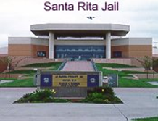
Santa Rita Jail, California
A facility deployment at the Santa Rita Jail and connected to Pacific Gas & Electric power system. 5th largest jail in the nation with 4,000 inmates.
This is an example of a facility island.
Distributed resources include:
1.2 MW rooftop photovoltaic system.
1 MW molten carbonate fuel cell for combined heat and power (CHP) operation.
A 2 MW 4 MWh Li-ion battery.
Designed capabilities:
Peak load reduction of 15%.
Ability to island and maintain critical operations during a blackout.
C. Marnay et. al, “A Green Prison: Santa Rita Jail Creeps Towards Zero Net Energy (ZNE),” ECEEE 2011 Summer Study France, June 2011

Slide 22
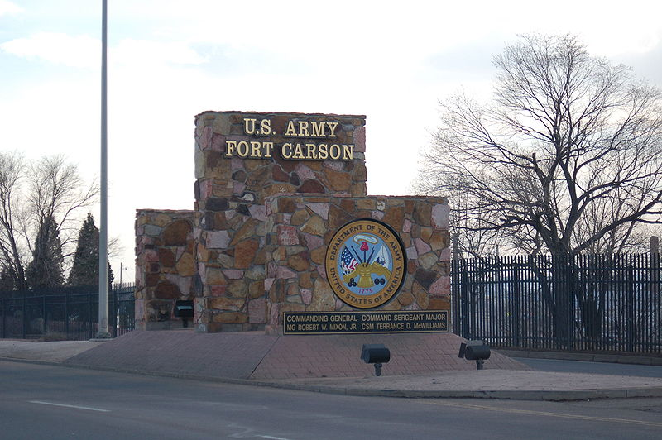
Smart Power Infrastructure Demonstration for Energy Reliability and Security (SPIDERS)
A joint projected between the U.S. Department of Energy and Department of Defense.
The goal is to deploy cyber secure microgrid capabilities on military bases to ensure continuity of critical operations in the event of a blackout.
This is an example of an facility island that can be composed of multiple substations.
Distributed resources include:
Solar PV
Wind generation
Batteries and electric vehicles
Demand response
Hydrogen facilities
Volt-VAR optimization
A major objective of this project is to add the beneficial capabilities of a microgrid while ensuring that the added equipment does not degrade the cyber security of the critical infrastructure.

Slide 23

Existing European Microgrid Implementations
Laboratory microgrid at National Technology University of Athens, Greece
Kythnos island, Greece
Mannheim-Wallstadt, Germany
Bronsbergen Holiday Park, Netherlands

Slide 24
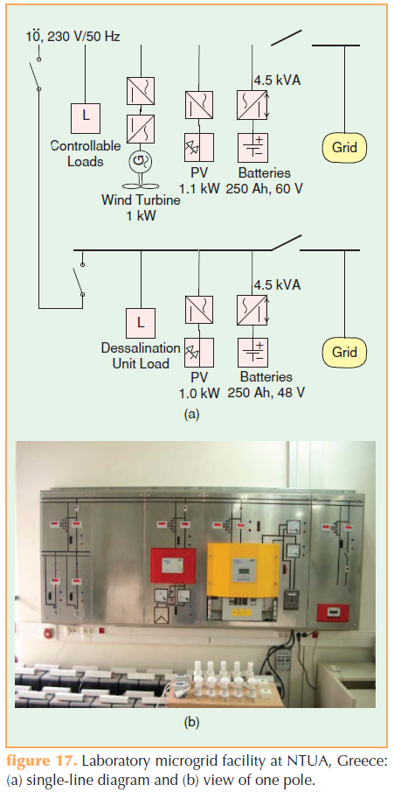
Laboratory Microgrid at National Technical University of Athens, Greece
This laboratory microgrid was constructed to test small-scale equipment and control strategies for microgrids.
Distributed resources include:
2 electrical buses.
Solar PV
Wind generation
Battery storage
Controllable loads
Control was achieved by operating the battery to load balance and using droop curves for voltage control.
The system could island and reconnect to the utility power system.
A multi-agent control system was examined for operation of the system.
B. Kroposki et. al, “Making microgrids work” IEEE Power & Energy Magazine, May/June 2008

Slide 25
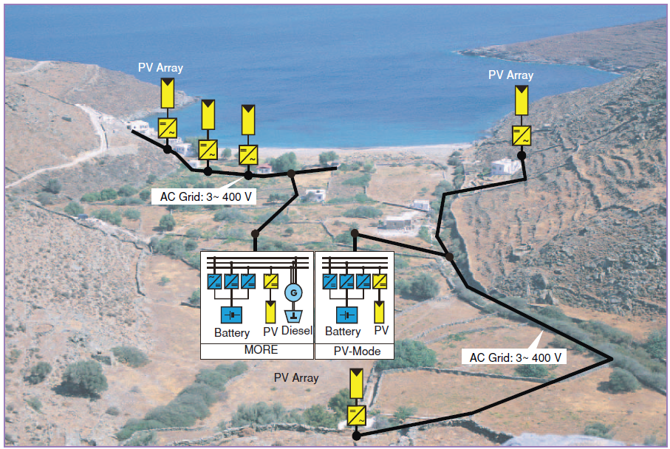
Kythnos Island, Greece
This is a small single phase microgrid supplying power to 12 houses on the island of Kythnos.
The microgrid was installed because the nearest MV line was 4 km away.
Distributed resources include:
Rooftop solar PV
Small diesel generator
Battery storage
Potential for a small wind generator
Centralized and decentralized control systems are being examined.
N. Hatziargyriou et. al, “Microgrids” IEEE Power & Energy Magazine, July/August 2007

Slide 26
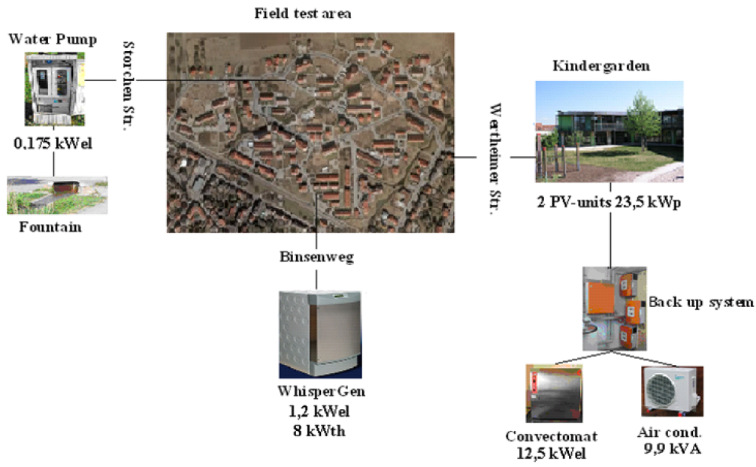
Mannheim-Wallstadt, Germany
This was an intermeshed ring grid structure connected to 3 MV/LV transformers.
This system is an example of an interconnected secondary island.
Distributed resources include:
Solar PV
Combined Heat and Power (CHP)
580 households
Encouraged customers to shift loads to high solar generation periods
Testing was conducted on transfer between interconnected and islanding mode.
The system evaluated the capabilities of agent-based decentralized control.
“Deliverable DF5: Report on Field Test for the Transfer between Interconnected and Islanding Mode at the Ecological Settlement in Mannheim-Wallstadt (MVV)” More Microgrids, December 2009

Slide 27
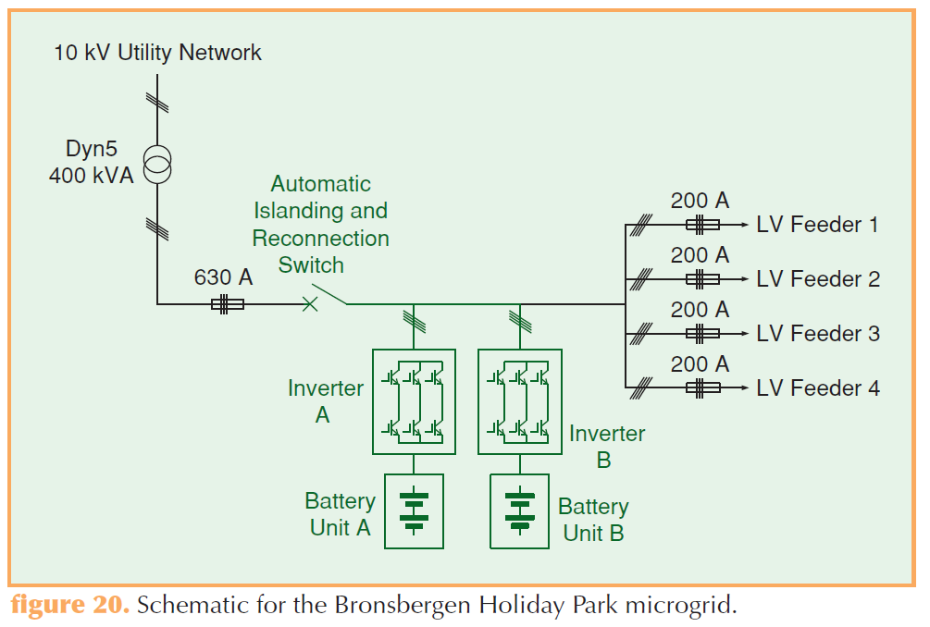
Bronsbergen Holiday Park, the Netherlands
This is a three-phase 400-V network, connected to a 10-kV medium-voltage network.
This system is an example of a an interconnected secondary island.
Distributed resources include:
Solar PV
Combined Heat and Power (CHP)
Battery storage
210 cottages
Evaluation of islanded operation, automatic isolation and reconnection, evaluation of fault levels, harmonic voltage distortion, energy management and storage lifetime optimization, and operations of converters in parallel.
B. Kroposki et. al, “Making microgrids work” IEEE Power & Energy Magazine, May/June 2008

Slide 28

Existing Japanese Microgrid Implementations
Aichi Microgrid
Hachinohe Microgrid
Sendai Microgrid

Slide 29
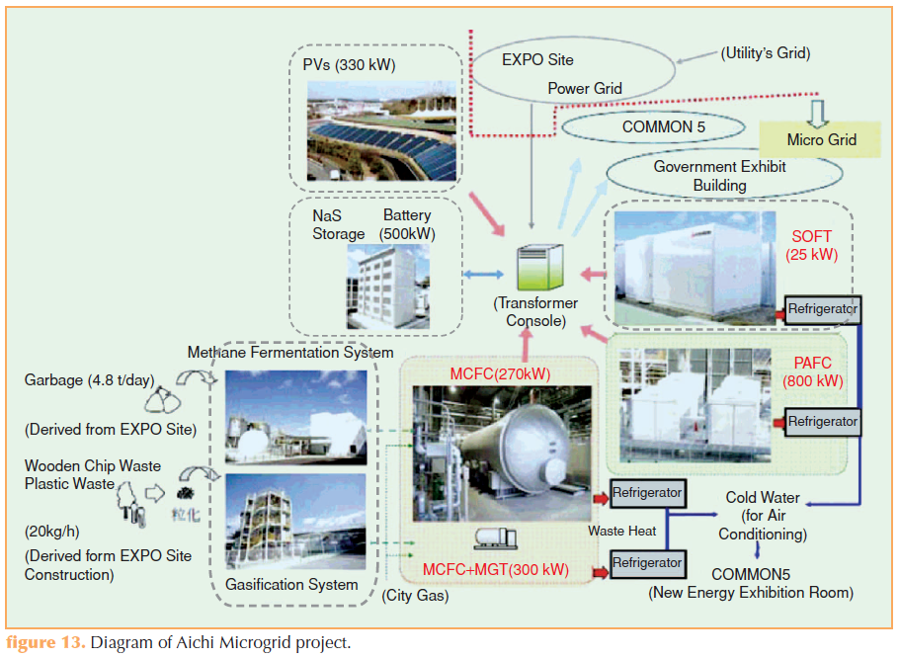
Aichi Microgrid, Japan
Control systems for matching energy demand and supply for microgrid operation.
This system is an example of a facility island.
Distributed resources include:
Molten carbonate and solid oxide fuel cells
Multi-crystal, amorphous silicon, and single crystal Solar PV
NAS battery storage
End-use loads
Examination of control algorithms for the load-generation balance were examined.
Load-generation balancing was maintained at 3% for as short as 10-minute intervals.
B. Kroposki et. al, “Making microgrids work” IEEE Power & Energy Magazine, May/June 2008

Slide 30
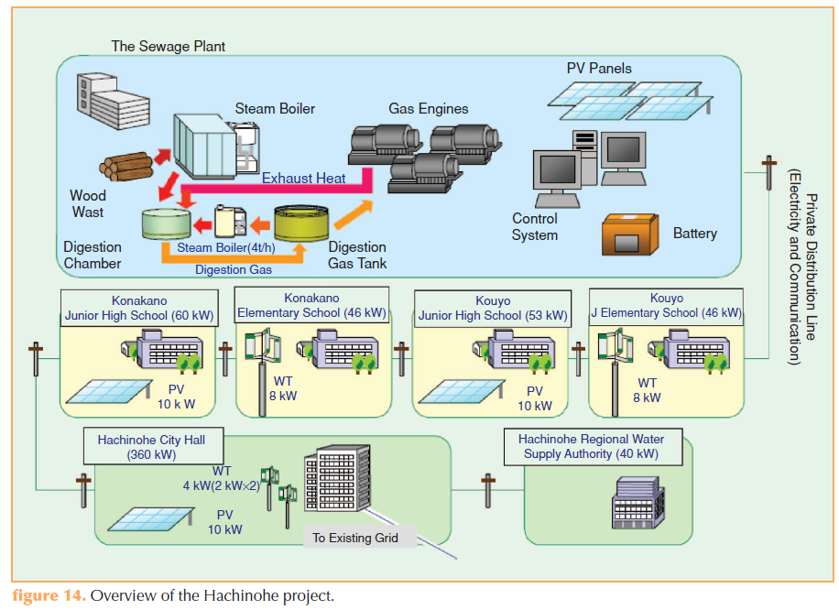
Hachinohe Microgrid, Japan
A 5 km long distribution line was constructed to connect the microgrid to the electrical power system. The system connects a sewage plant as well as 4 schools together.
This system is an example of a lateral island.
Distributed resources include:
Solar PV
Wind generation
Bio generation
4 schools and water authority are connect on line
Weekly supply and demand planning, economic dispatch control every 6 minutes, and second-by-second power flow control at interconnection
3% balancing error, over 6 minute time frame, during 99.99% of the system’s operational time
During a 1 week outage phase imbalances were manages with the PV inverters.
B. Kroposki et. al, “Making microgrids work” IEEE Power & Energy Magazine, May/June 2008

Slide 31
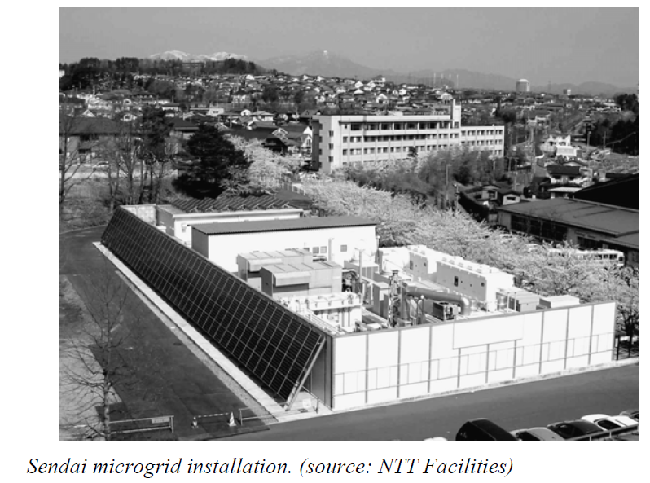
Sendai Microgrid, Japan
This is a microgrid in the area of Sendai Japan that interconnects a high school, a medical school, and a water treatment plant.
This system is an example of a facility island at Tohoku Fukushi University.
Distributed resources include:
Solar PV
Fuel cells
Natural gas micro turbines
Combines Heat and Power (CHP) from the fuel cells and micro turbines is used for heating.
During the October 26th 2011 9.0 magnitude earthquake and subsequent tsunami, the Sendai microgrid remained in operation when the majority of the local power systems failed.

Slide 32

Existing Canadian Microgrid Implementations
Fortis - Alberta
Boston Bar - British Columbia

Slide 33
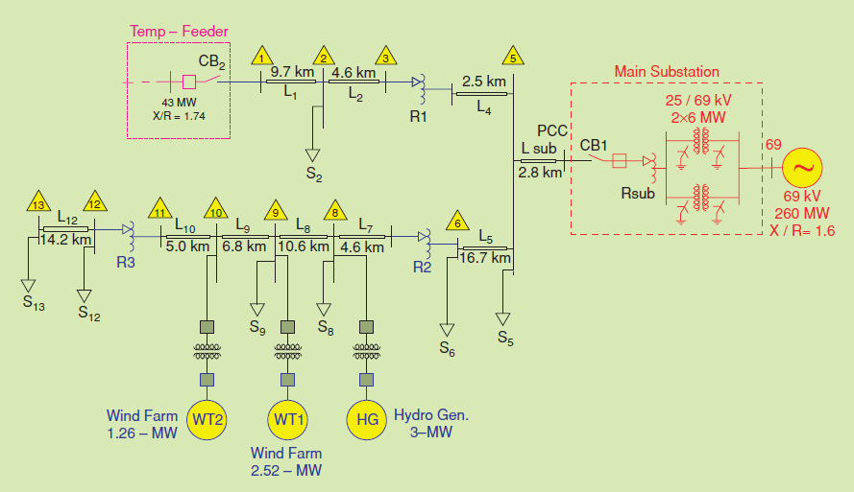
Fortis-Alberta, Canada
A 25 kV distribution feeder can be isolated from its substation and supplied by local distributed resources.
This is a full-scale field demonstration to examine the following:
Frequency and voltage control methods
Transition between grid connected and islanded operation
Impact of high penetrations of DERs
This system is an example of a circuit island.
Distributed resources include:
Wind generation
Hydro. generation
Because of the intermittency of the wind and the slow response of the hydro., only planned islanding is allowed.
N. Hatziargyriou et. al, “Microgrids” IEEE Power & Energy Magazine, July/August 2007

Slide 34
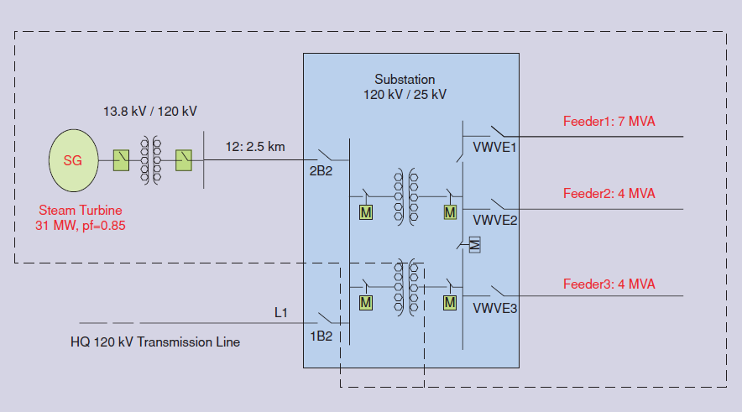
Senneterre – British Columbia, Canada
A portion of the Senneterre substation, including 3 feeders, can be islanded.
This system is an example of a substation bus island.
Distributed resources include:
Hydro. generation
Designed to examine the following issues:
Load management
Load following capabilities
Generator control and protection
Resynchronization capabilities
Black start capabilities
N. Hatziargyriou et. al, “Microgrids” IEEE Power & Energy Magazine, July/August 2007

Slide 35
Part 4: Microgrid Control
Just like any other electrical power system microgrids must be controlled.
Frequency and voltage must be maintained in a dynamic environment.
Because of the lack of interconnections with adjacent power systems resources cannot be shared.
As a result, there are fewer reserves and the systems have less inertia which present a challenging control environment.

Slide 36
Microgrid Control Issues
In an interconnected power system frequency is maintained by the large central generation units.
At the distribution feeder level the substation transformer provides what appears to be an infinite or stiff bus.
Frequency is independent of the load at a single feeder.
Voltage is controlled by a combination of central generating units and distributed voltage control devices. Since reactive power can not be effectively transferred long distances, voltage control is generally a local operation.
In a microgrid, there is no stiff bus and the individual generators must operate together.
Changes in load can cause significant changes in frequency.
The lack of a central control can cause inter machine oscillations.
In a microgrid, voltage is controlled by the local generation and other voltage control devices.
There are multiple control strategies for microgrids:
Central
Decentralized
Hierarchical

Slide 37
Basic Physics of Microgrid Stability
Frequency Control
Voltage Control
Frequency is determined by the speed of rotating machines or the output of inverters.
In a microgrid, the system is not supported by large central generators with large inertial masses.
The classical swing equation can be used to determine the frequency in a system.
Voltage is generally a local effect and as such is more easily controlled on a microgrid.
It is controlled by the generators and other voltage control devices.
Voltage control is a mid-term dynamics problem.

Slide 38
Frequency Control
In an interconnected power system the frequency is determined by the speed of the generators. At nominal speed the generators produce 60 Hz.
There is only a single value of frequency in an interconnected power system, with all generators operating in synchronism.
These same basic principles apply to a microgrid, it is only the characteristics and controls that change.
The machines on a microgrid are significantly smaller, with the largest load sometimes the size of a single generator.
In general, the machines on a microgrid do not have all of the control features of a large central plant machine.

Slide 39
Transfer Function Representation of the Swing Equation Single Machine Infinite Bus (SMIB)

Slide 40
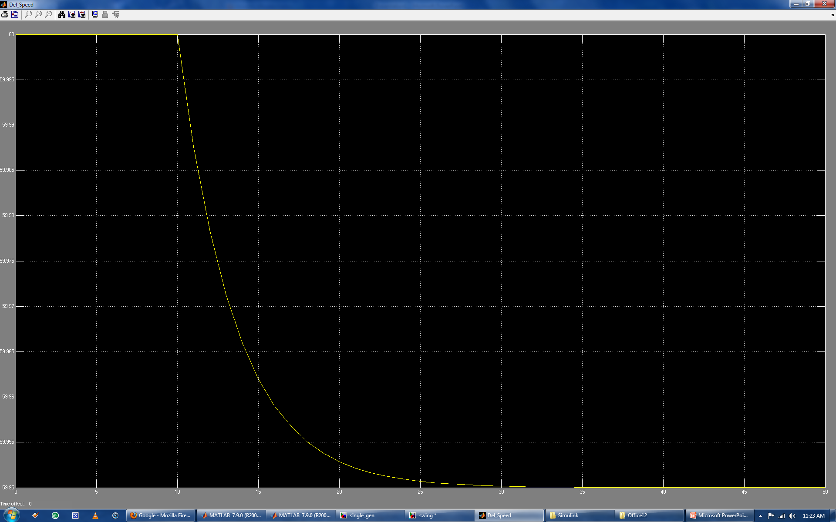
SMIB Frequency Response to Load Change
The classical representation of a generator is a simple rotating mass.
As a result, there are no control devices to bring the frequency back to nominal after the change in load.
While the SMIB model forms a basis for analysis, more complicated models are necessary.

Slide 41
Transfer Function Representation of the Swing Equation
The swing equation only accounts for the behavior of a rotating mass, there are many other components to a generator.
Sub-transient model
Transient model
Governor
Voltage regulator
Power System Stabilizer (PSS)
Each of these elements adds to the complexity of the generator representation.
The simple second order swing equation quickly becomes a seventh or eight order coupled differential equation for each generator in the system.

Slide 42
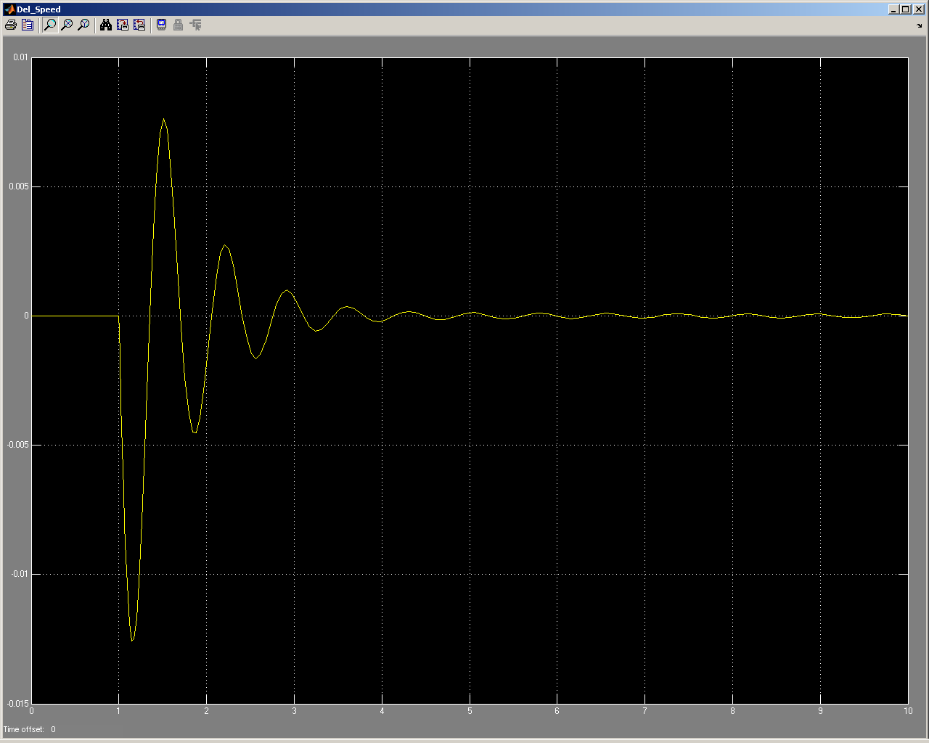
Generator Frequency Response to Load Change
This plot is for the frequency deviation of a generator with a speed governor.
Unlike the classical model, frequency returns to nominal after the disturbance because of the operation of the governor.
This is the type of control that is necessary in a microgrid.

Slide 43
Multiple Machines
Normally generators are designed to operate either independently or in an interconnected system.
Independent: The generator is the only source of power and as such it actively regulates the frequency and voltage.
Interconnected System: The generator outputs power according to a dispatch, it may be part of automatic generation control if it is large enough.
In a microgrid it is common to find multiple generating units without a central control system, each generator operating with its own open loop controller.
The best way to handle the coordination of multiple open loop control systems is through the use of droop characteristics.

Slide 44
Droop Curve
As the load on the generator increases, the frequency decreases slightly.
The change in frequency is very small <.1 Hz.
For a single generator operating in isolation a droop characteristic is not necessary.
But for generators operating in parallel it is necessary.

Slide 45
Droop Curve
In the figure there are two generators with the electrical load shown by the magnitude of the dashed line.
The slope of the two droop curves decide which generator picks up what percentage of the load.
The house curves can be moved up or down to change load, and frequency.
In this way the load is properly distributed among the generators and there are not oscillations between regulators.
The same principles can be used on the voltage regulators.

Slide 46
Example – Adjustment of Gen 2. Load
Original set points with frequency at 60.3 Hz
Generator 2 is partially unloaded by adjusting it’s droop curve down, but frequency is now 60.2 Hz

Slide 47
Example – Adjustment of Gen 2. Load Cont.
Generator 2 partially unloaded, but frequency is now 60.2 Hz
Both set points are lowered so load in unaffected but frequency is lowered to 60.0 Hz.

Slide 48
Voltage Control
If there is a microgrid with a single generator then voltage control is achieved in the traditional manner.
The voltage regulator on the generator sets the voltage and any regulators or capacitors assist.
A voltage regulator on a generator adjusts the field excitation on the rotor, with response times of well below 1 second.
Because regulators and capacitors have time delays and require the operation of physical switches they will respond much slower than the voltage regulator on the generator.
If more than one generator exists on the microgrid then it is necessary to coordinate their voltage control.
Droop curves similar to those used for frequency control can be used.
For frequency control the droop curves apply to the governors, and for voltage control the droop curve is applied to the voltage regulator.

Slide 49
Central Control
In a centralized control system all control signals originate from a single location.
There may be local control action in the form of a governor but individual elements do not coordinate with each other.
At the point of central control there is a global view of the system that allows for effective decision making.
This is an effective system but communication times can be increased because of the need for all information to be routed through the central control center.
The loss of the central control center can result in a total collapse of the system.

Slide 50
Decentralized Control
In a decentralized control system there is no central control.
Individual agents on the system operate locally with information, and commands, being passes between one another.
In these systems decision are made based on local information and the global view of the centralized system is lost.
Communications must exist between all agents.
Decentralized systems tend to be very robust since the loss of any one agent in the system is not critical.

Slide 51
Hierarchical Control
A combination of centralized and decentralized control.
In these types of systems it is possible for local agents to act independently to a predetermined level.
Some control signals can only originate from the central control center.
In other schemes the agents can perform all actions but the central control can veto the decision after the fact.
These system can be very robust because of the decentralized components and still have effective global decision making capabilities.

Slide 52
Module 10 Concluding Comments
Early power systems were examples of microgrids, but economies of scale lead to the modern interconnected power system.
Microgrids offer a potential mechanism for the integration of a large number of DERs.
According to IEEE std. 1547.4 microgrids can be classified according to their configuration.
In the last decade there have been a number of microgrid demonstration projects around the world.
Just like an interconnected power system, a microgrid must properly regulate voltage and frequency.
Because of their isolated nature, microgrids present some unique controls issues.

Slide 53
Substation and Distribution Automation
Conclusion of Module 10: Introduction to Micro-Grids

